Slide 1

Fortune group of hotels hospitality analysis report
Designed and Presented By:
Nikhil K

Slide 2
Problem statement:
Fortune Group of Hotels owns multiple five-star hotels across India. They have been in the hospitality industry for the past 20 years. Due to strategic moves from other competitors and ineffective decision-making in management, Fortune Group of Hotels are losing its market share and revenue in the luxury/business hotels category.
As a strategic move, the managing director of Fortune Group of Hotels wanted to incorporate “Business and Data Intelligence” to regain their market share and revenue.

Slide 3
Fortune Group of Hotels

Slide 4
Fortune Group of Hotels

Slide 5
Fortune Group of Hotels
Bangalore
Delhi
Mumbai
Hyderabad

Slide 6
Fortune Group of Hotels
Delhi
Bangalore
Fortune Bay
Fortune Blu
Fortune City
Fortune Grands
Fortune Palace
Mumbai
Hyderabad
Fortune Bay
Fortune Blu
Fortune City
Fortune Exotica
Fortune Grands
Fortune Palace
Fortune Bay
Fortune Blu
Fortune City
Fortune Exotica
Fortune Grands
Fortune Palace
Fortune Seasons
Fortune Bay
Fortune Blu
Fortune City
Fortune Exotica
Fortune Grands
Fortune Palace

Slide 7
Dataset Details:
We are provided 3 moths booking details data of all the Fortune Group of hotels.
Dataset contains 5 excel files.
Date
Hotels
Rooms
Aggregated_ Fact_bookings
Fact_bookings

Slide 8
Expected outcome after this analysis?
Regain their market share in the luxury/business hotels category.
Understanding the revenue trend by week/month/day
To get insights where business is failing and what can be done to tackle them

Slide 9
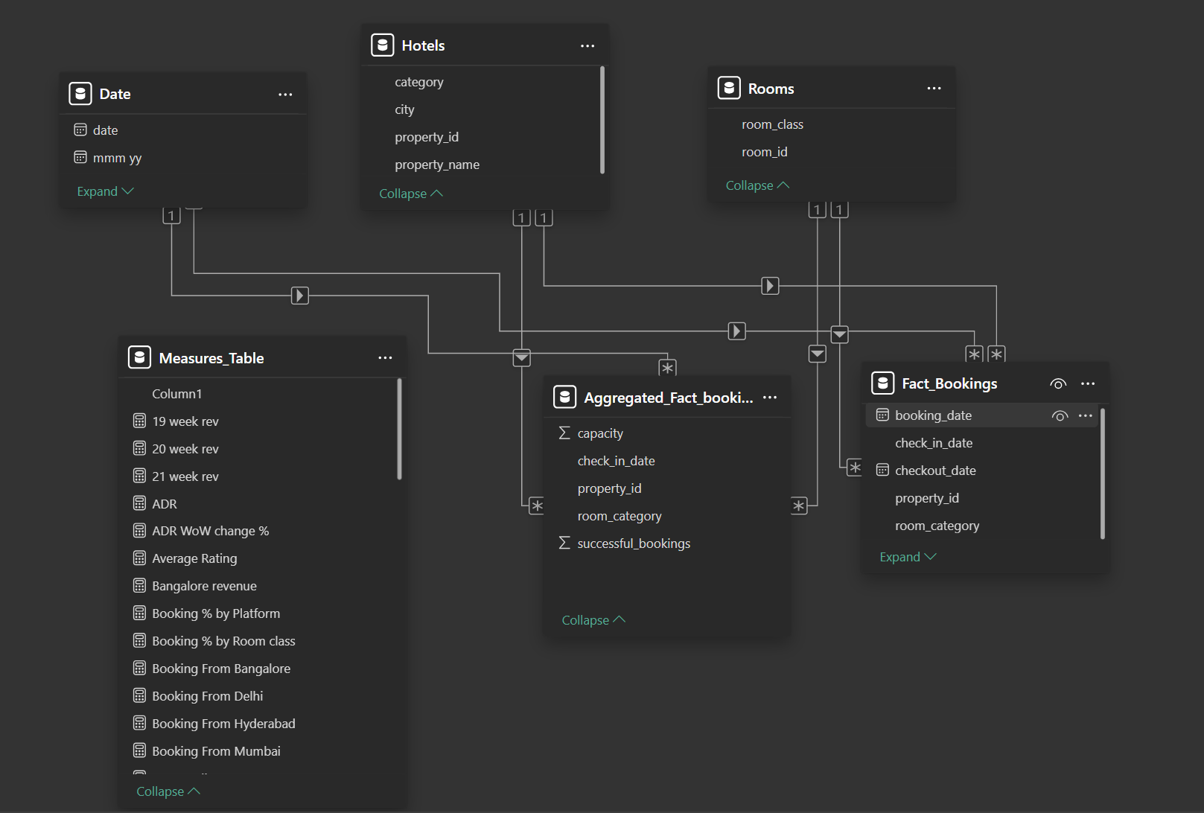
Data Model:

Slide 10
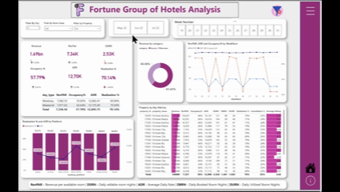

Slide 11


